Slide 1
Software Requirements Specification
SE 801: Project

Slide 2
Project Name: IIT Academic Automation System
Presented by –
Jobayer Ahmmed
BSSE 0502
Supervisor –
Md. Nurul Ahad Tawhid
Assistant Professor
Institute of Information Technology
University of Dhaka

Slide 3
Overview
Requirements
Scenario-based Model
Data Model
Class-based Model
Behavioral Model
References

Slide 4
Requirements
Normal requirements:
Program officer –
Manage batches according to different programs.
Manage students according to program, batch, semester and course.
Manage courses according to program, batch and semester.
Manage teachers according to course.
Teacher –
Manage course contents.
Student –
Get information about offered courses in a program and semester, taken courses in a semester, and course teachers.
Know about courses – course credits, dependent courses of a course etc.
Download course content.

Slide 5
Requirements
Expected requirements:
A web-based application
User with individual user account
User friendly interface
Exciting requirement:
Responsive web pages

Slide 6
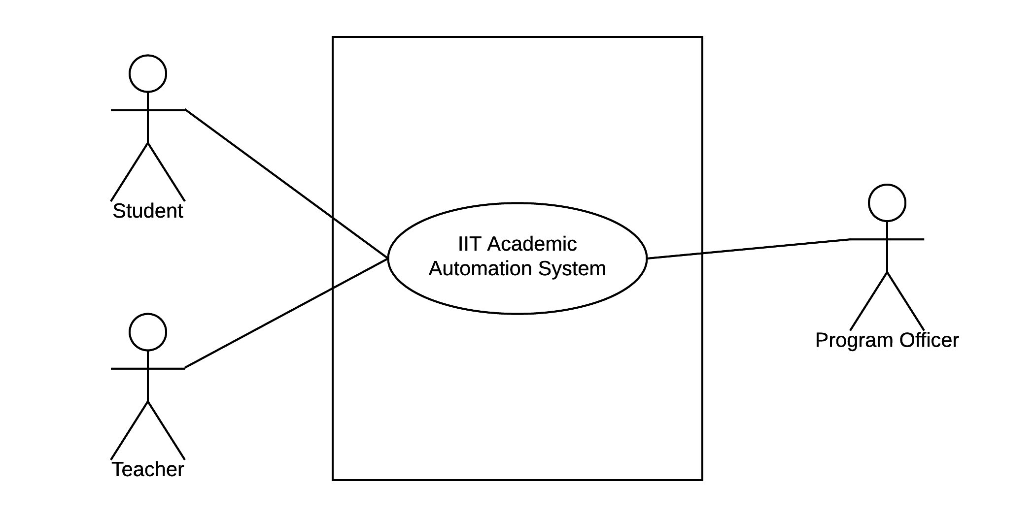
Scenario-based Model
Use case diagram: Level 0 – IIT Academic Automation System

Slide 7
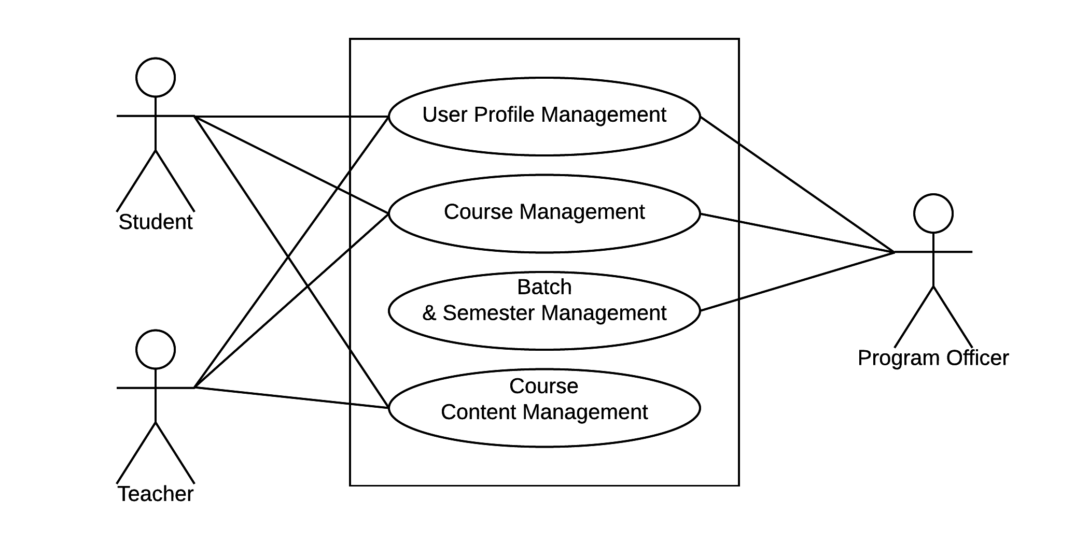
Scenario-based Model
Use case diagram: Level 1 – IIT Academic Automation System

Slide 8
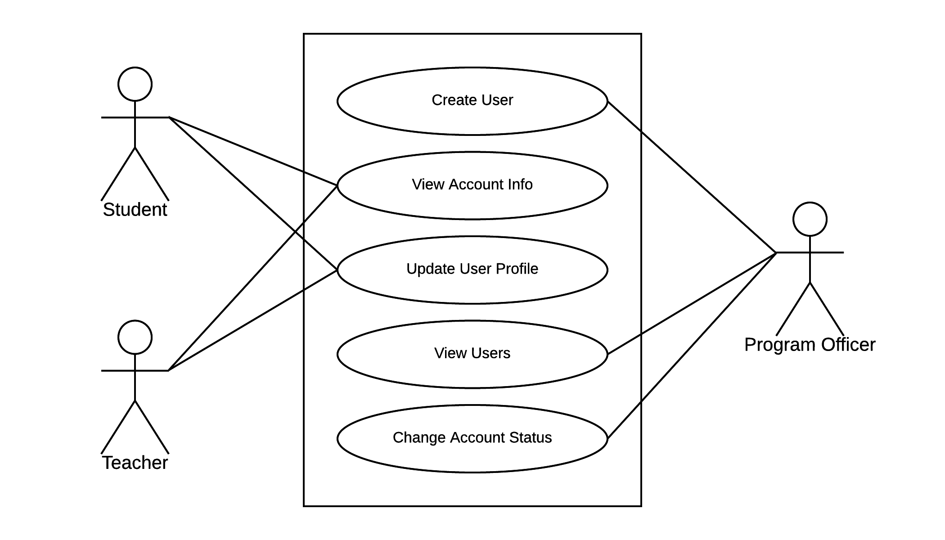
Scenario-based Model
Use case diagram: Level 1.1 – User profile management

Slide 9
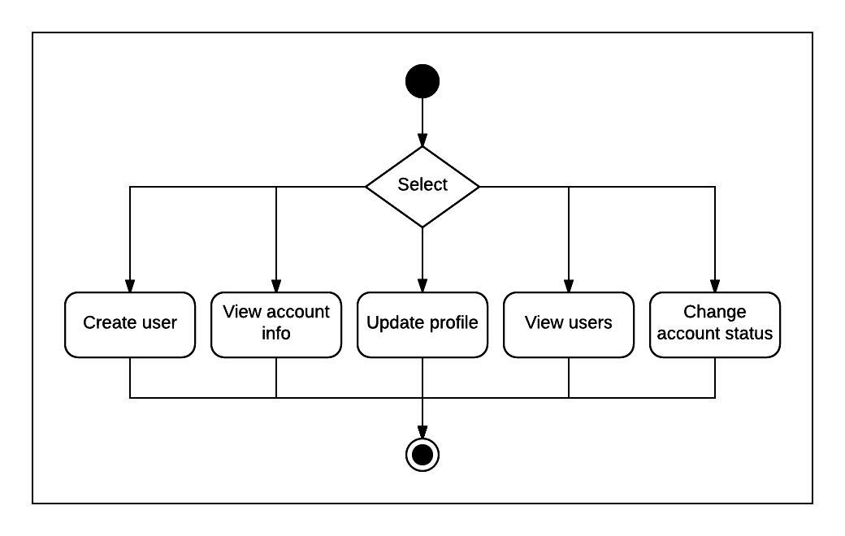
Scenario-based Model
Activity diagram: User profile management

Slide 10
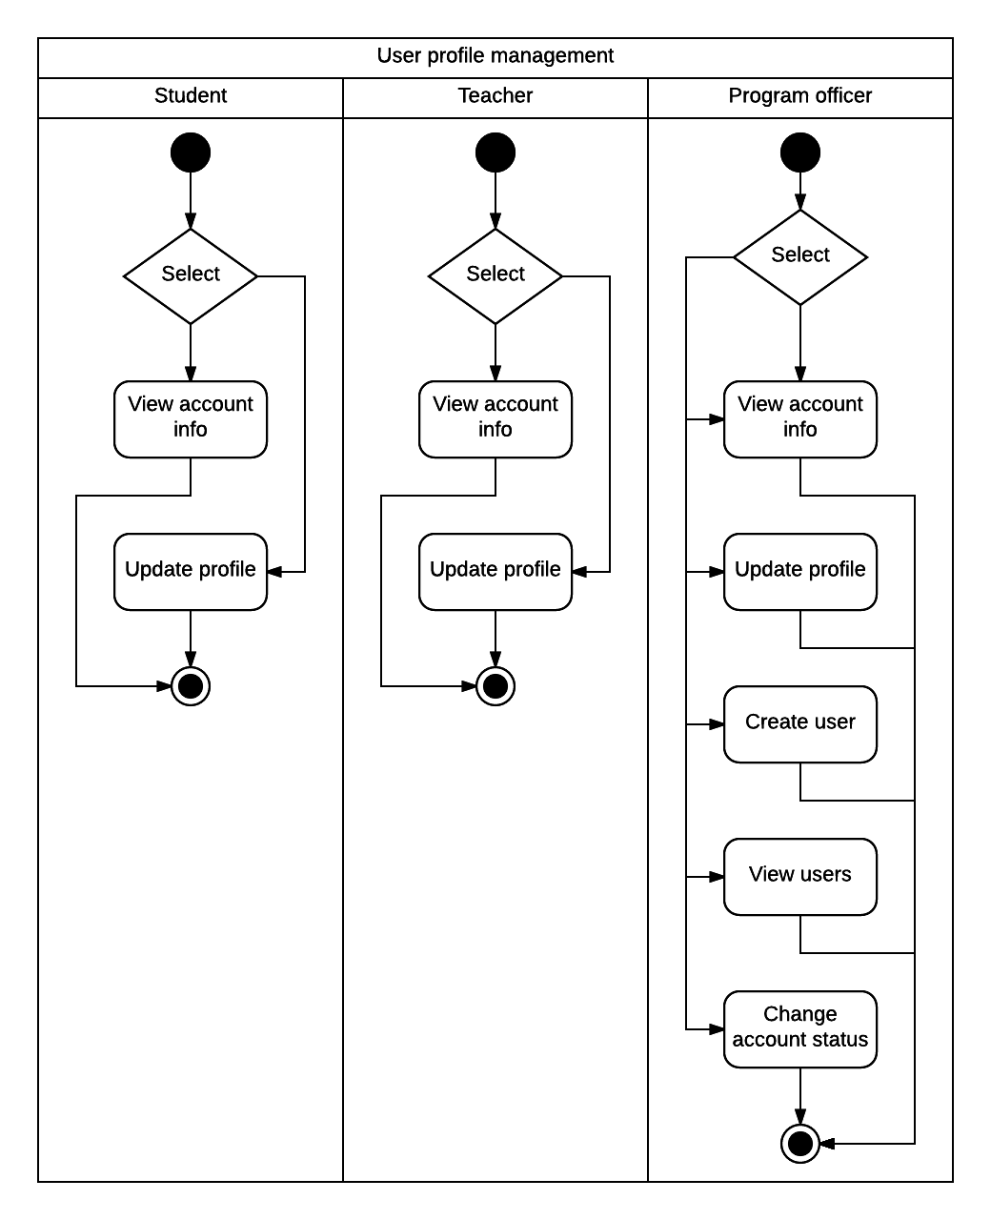
Scenario-based Model
Swimlane diagram: User profile management

Slide 11
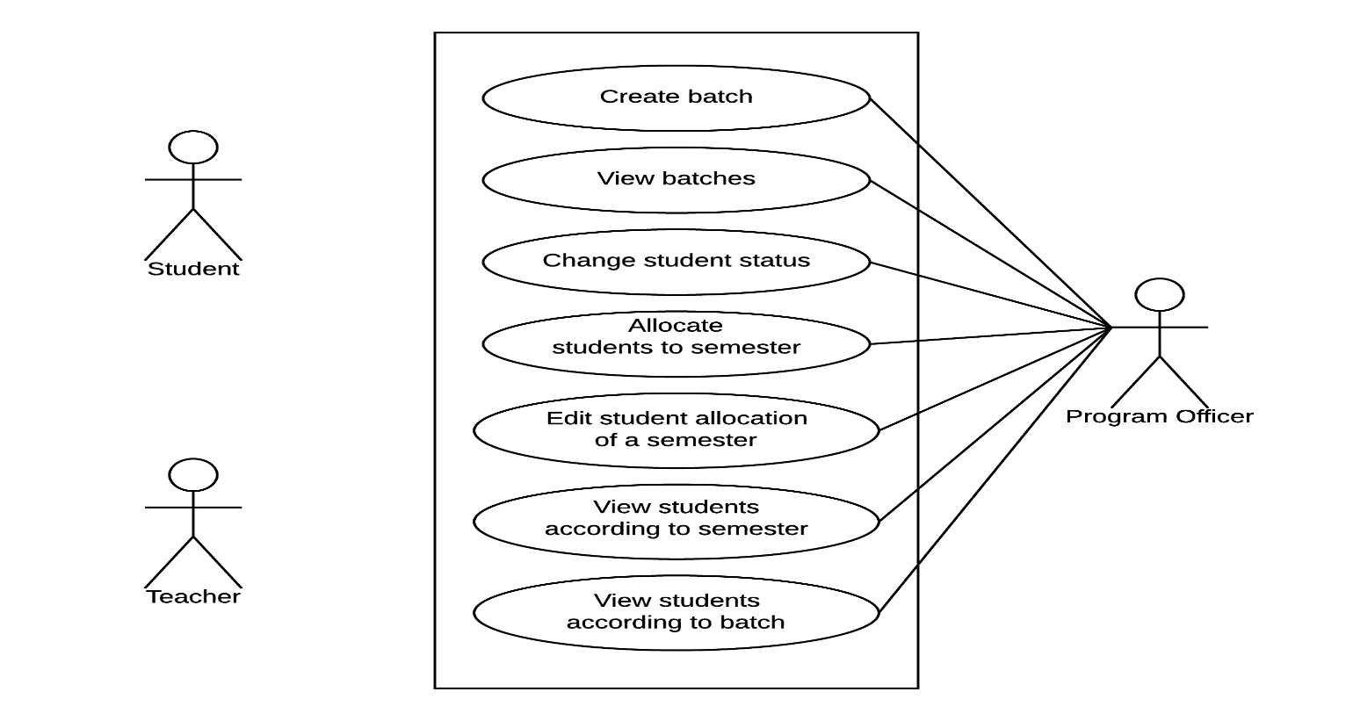
Scenario-based Model
Use case diagram: Level 1.2 – Batch & semester management

Slide 12
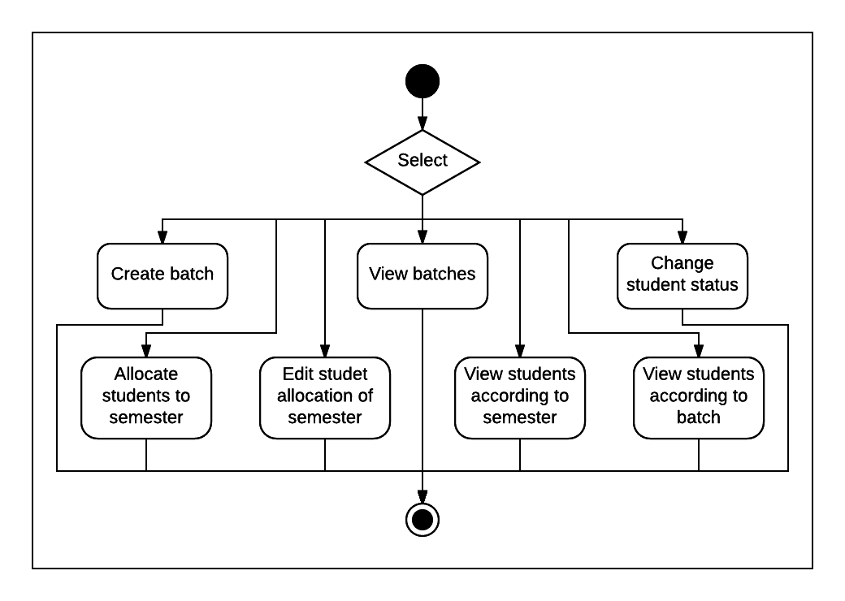
Scenario-based Model
Activity diagram: Batch & semester management

Slide 13
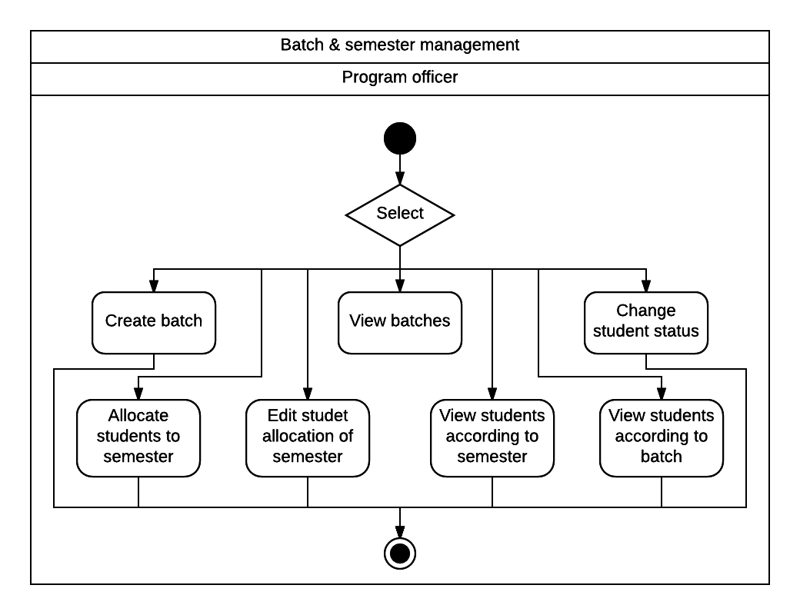
Scenario-based Model
Swimlane diagram: Batch & semester management

Slide 14
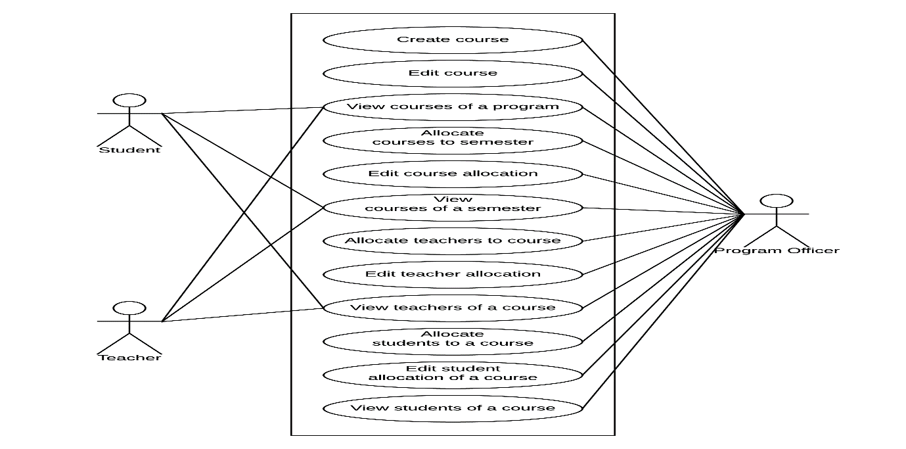
Scenario-based Model
Use case diagram: Level 1.3 – Course management

Slide 15
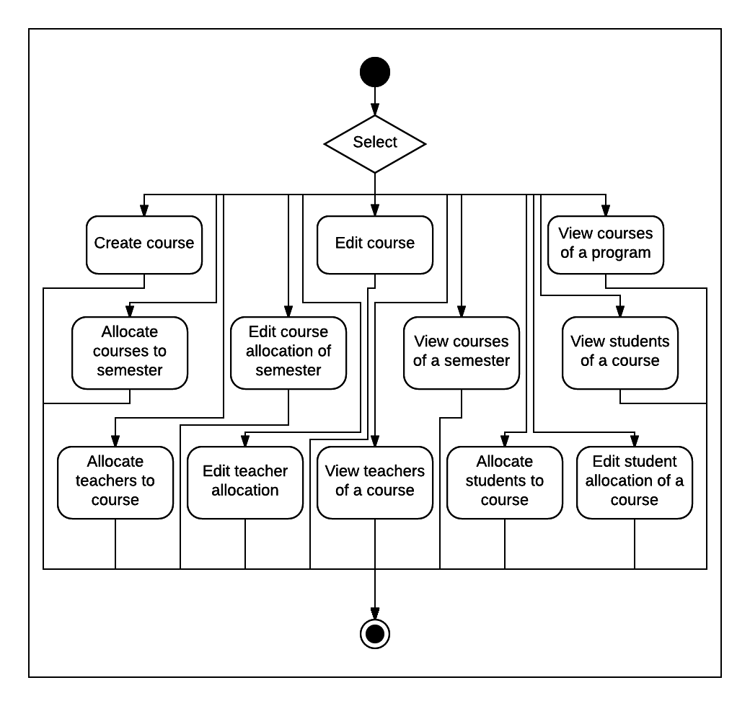
Scenario-based Model
Activity diagram: Course management

Slide 16
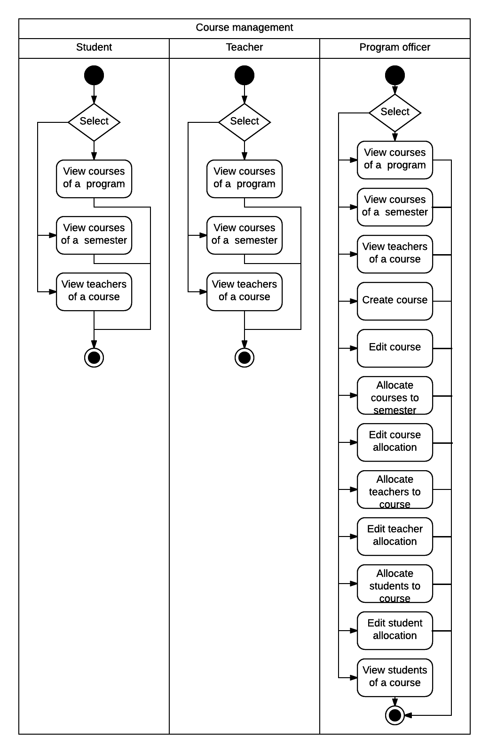
Scenario-based Model
Swimlane diagram: Course management

Slide 17
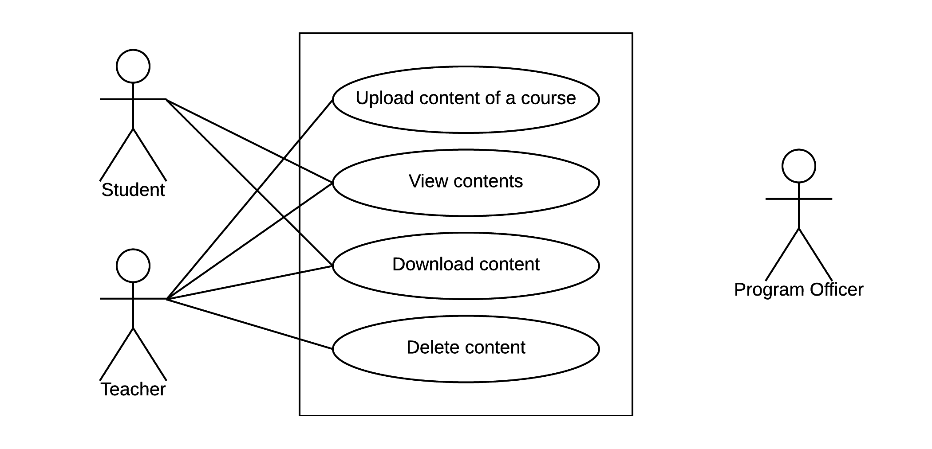
Scenario-based Model
Use case diagram: Level 1.4 – Course content management

Slide 18
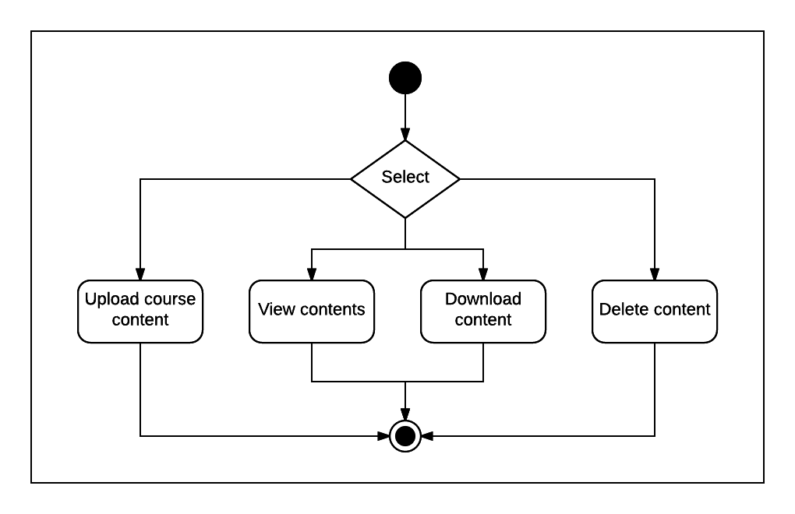
Scenario-based Model
Activity diagram: Course content management

Slide 19
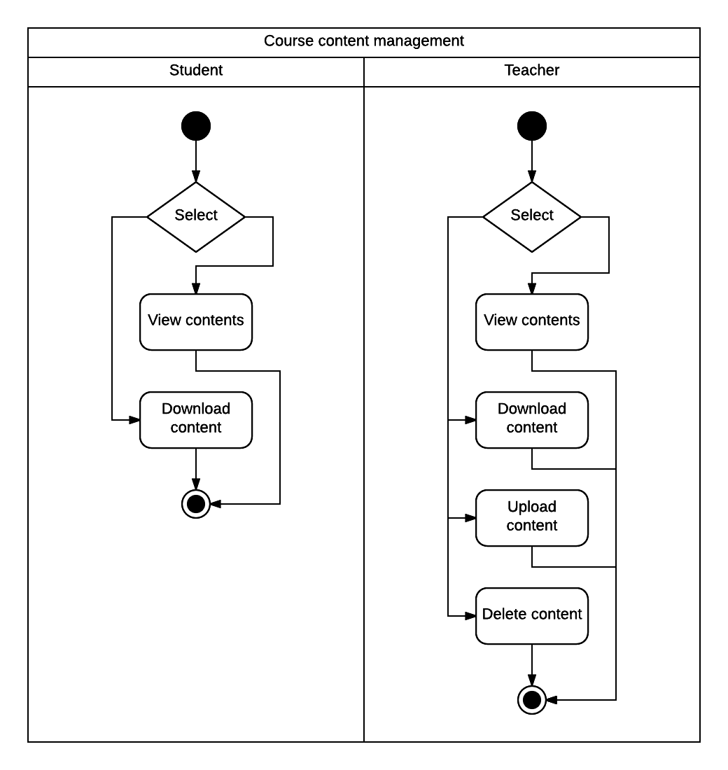
Scenario-based Model
Swimlane diagram: Course content management

Slide 20
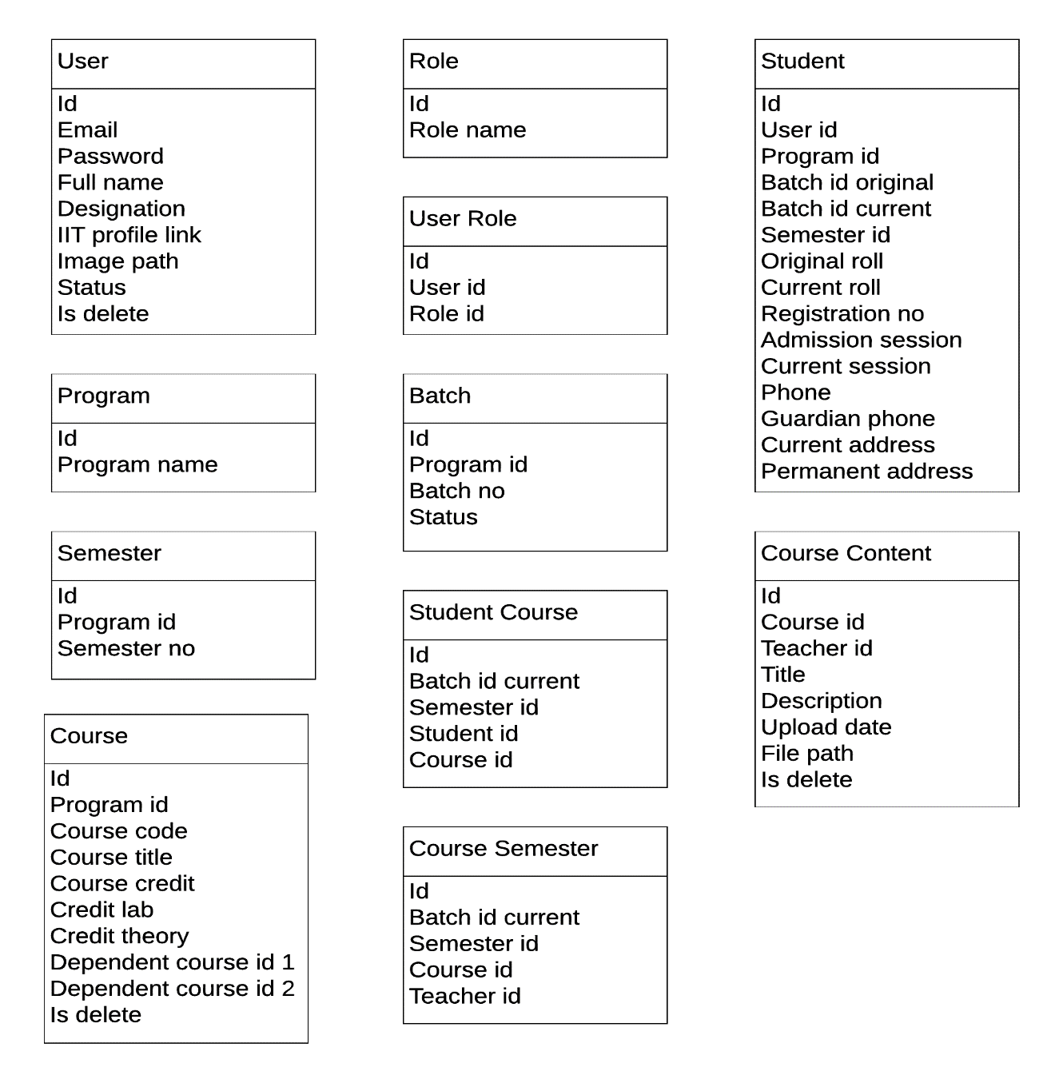
Data Model
Data objects

Slide 21
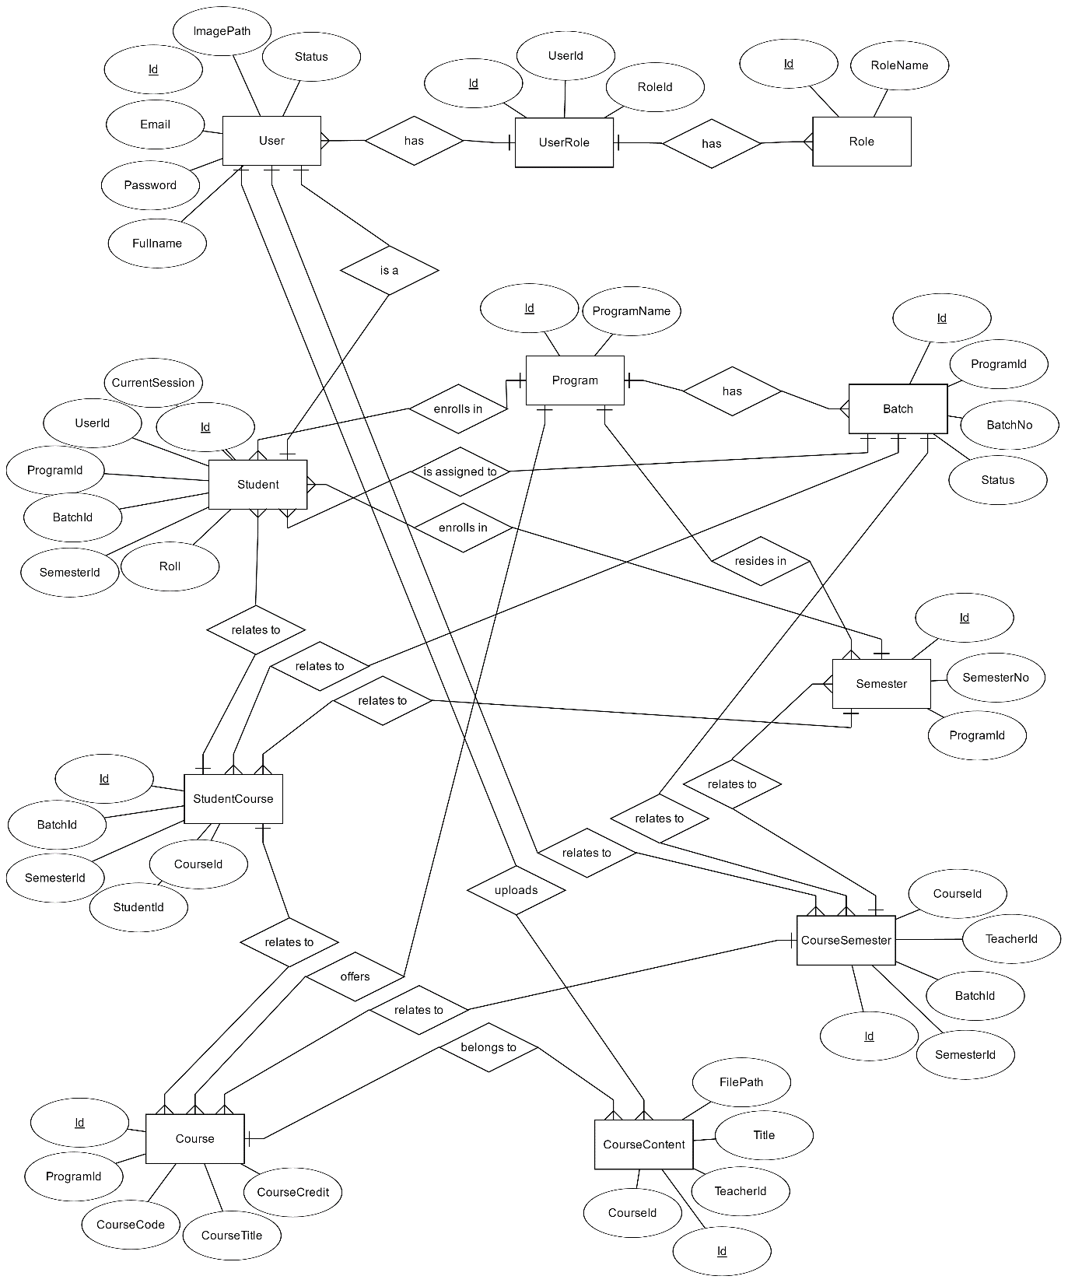
E-R diagram

Slide 22
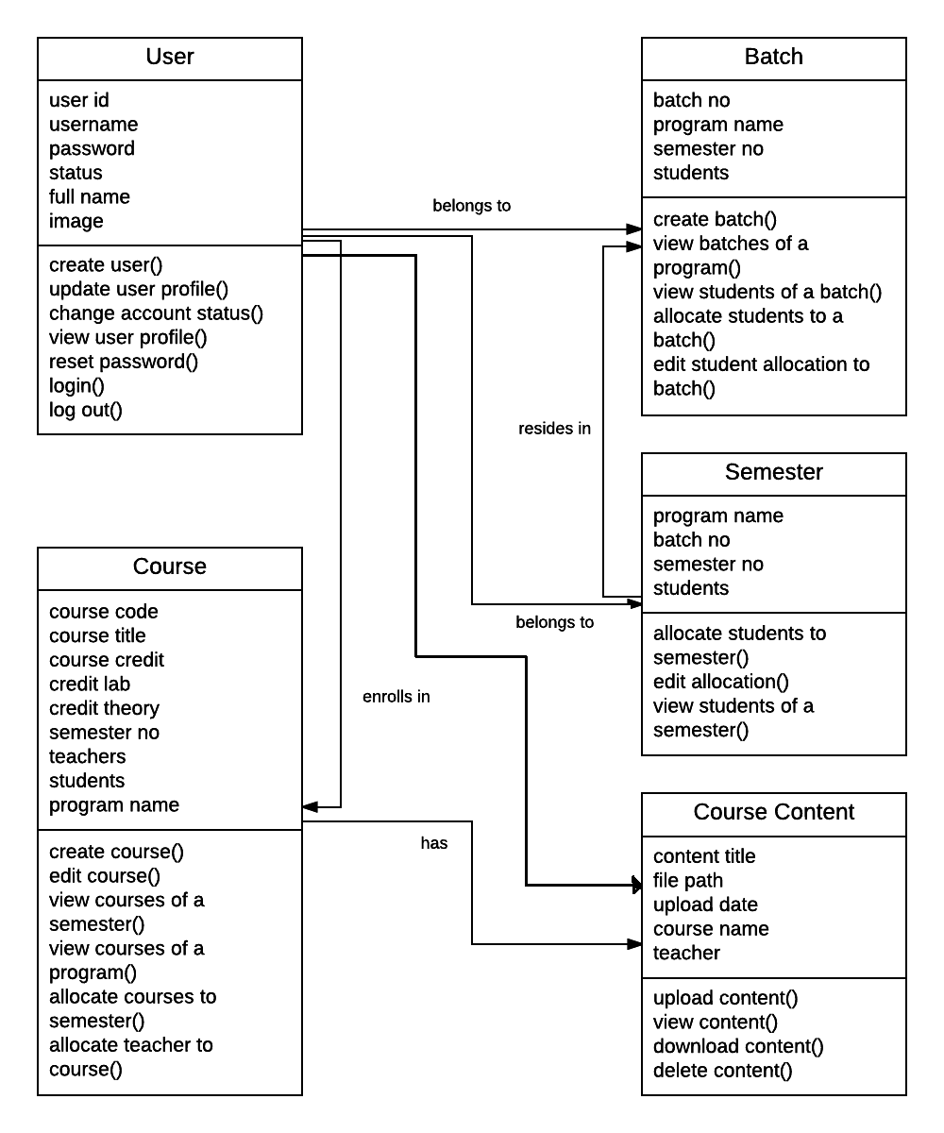
Class-based Model
Class diagram

Slide 23
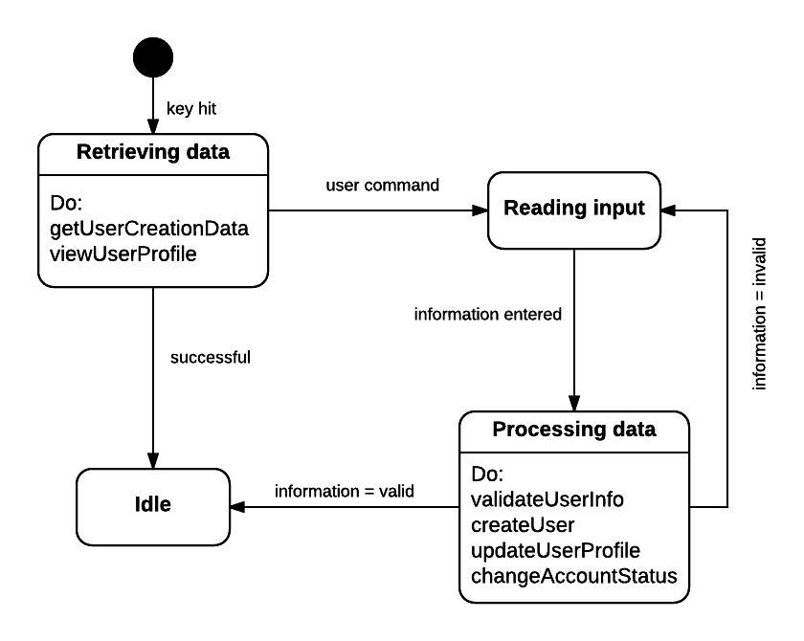
Behavioral Model
State diagram: User

Slide 24
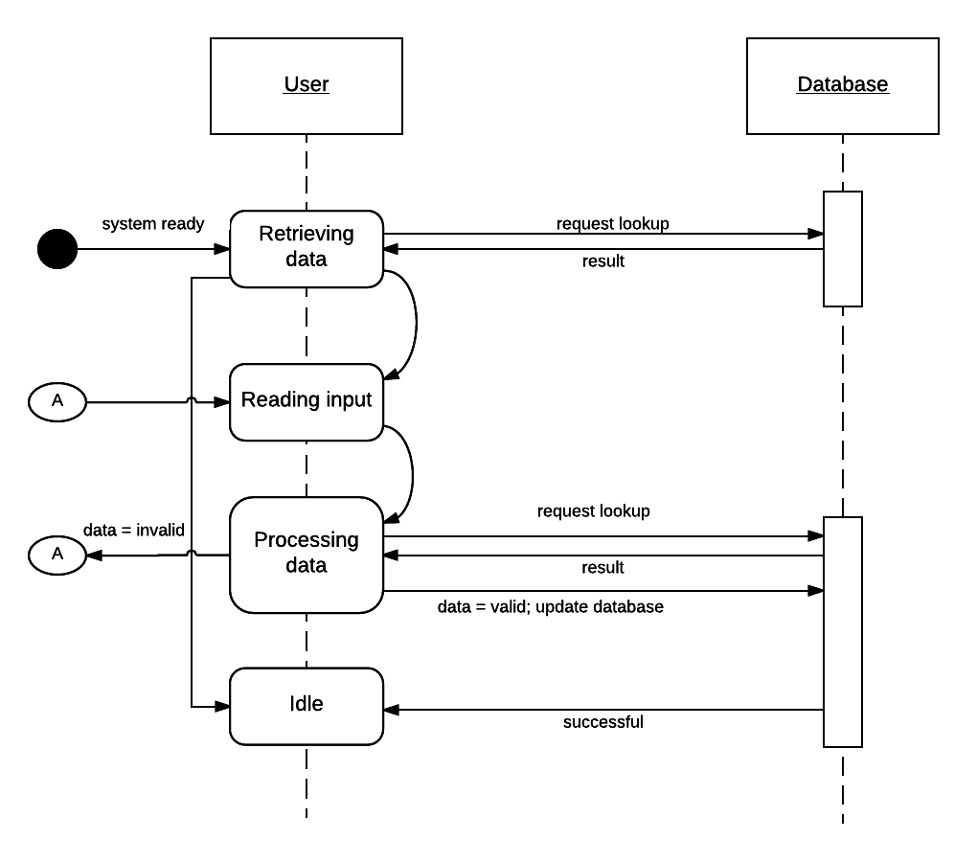
Behavioral Model
Sequence diagram: User

Slide 25
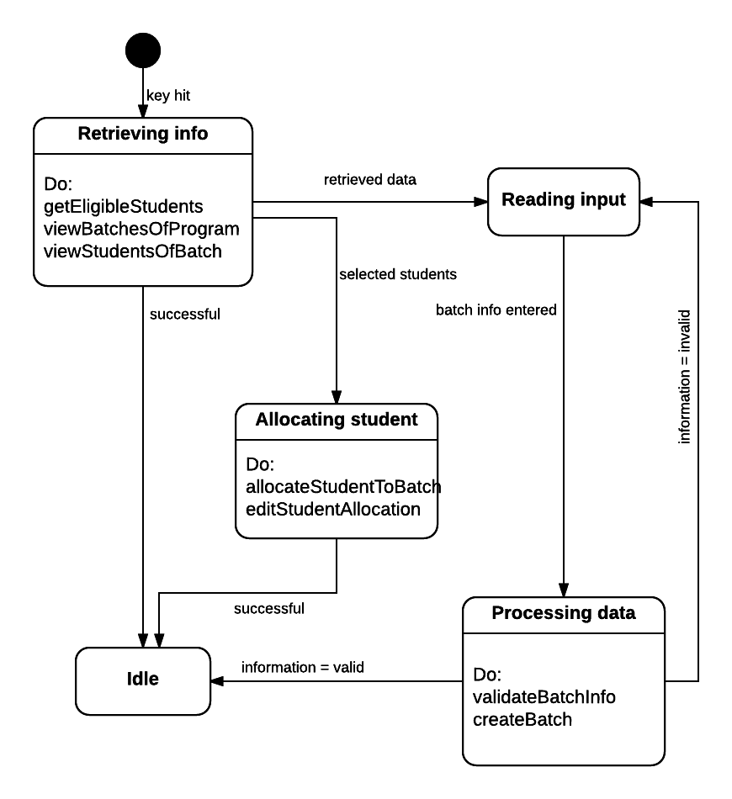
Behavioral Model
State diagram: Batch

Slide 26
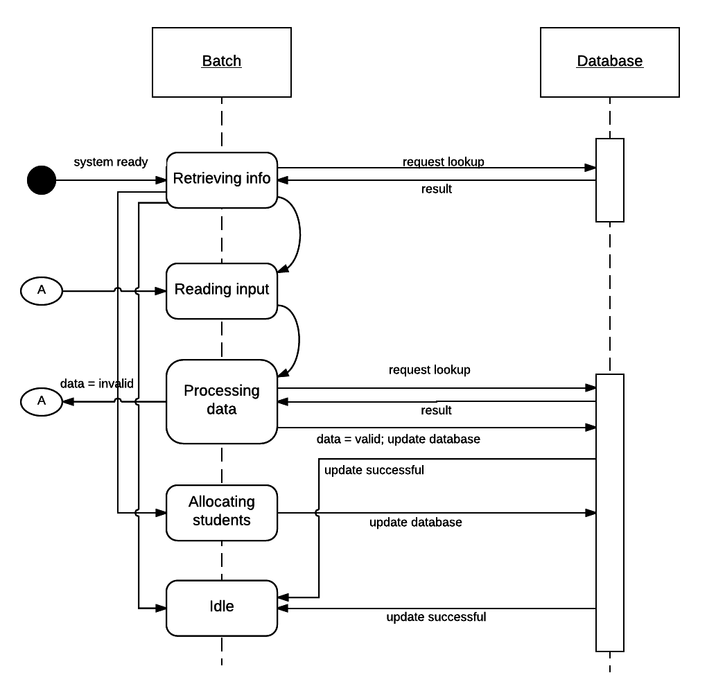
Behavioral Model
Sequence diagram: Batch

Slide 27
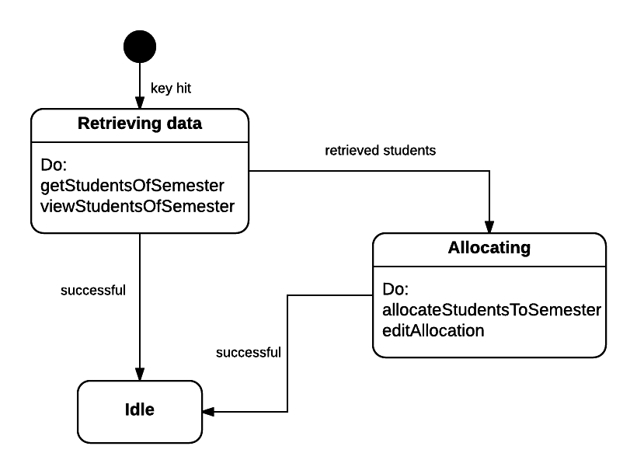
Behavioral Model
State diagram: Semester

Slide 28
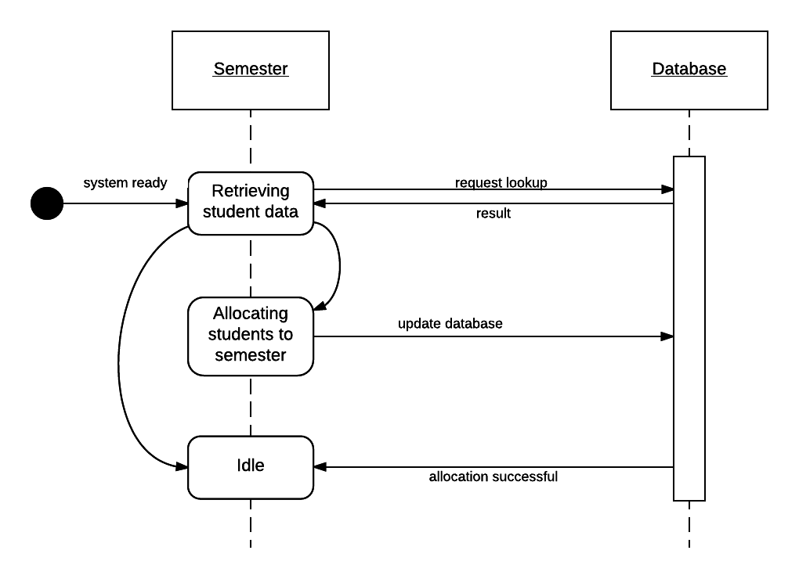
Behavioral Model
Sequence diagram: Semester

Slide 29
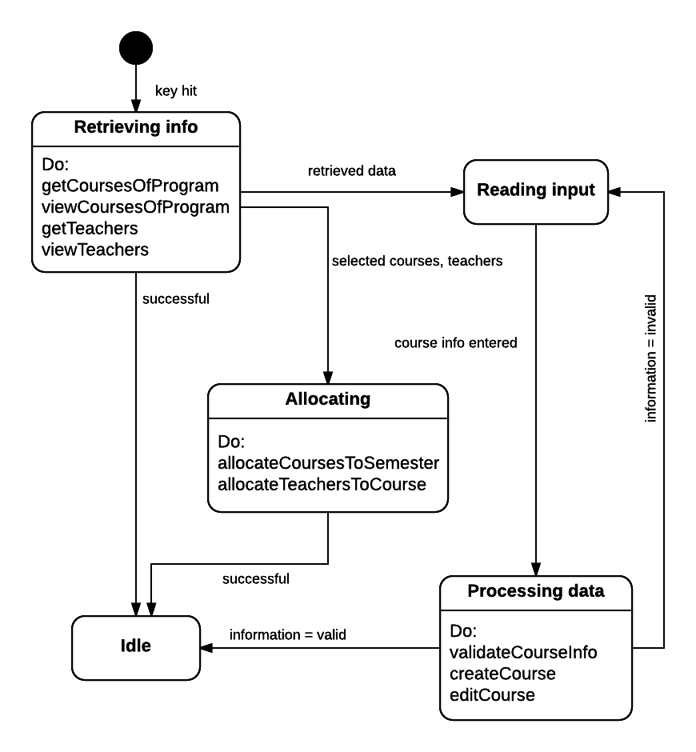
Behavioral Model
State diagram: Course

Slide 30
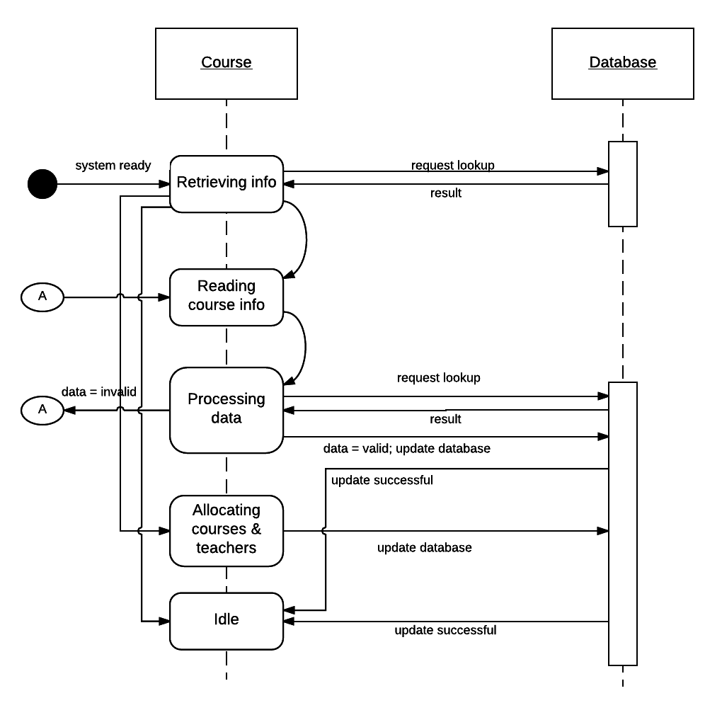
Behavioral Model
Sequence diagram: Course

Slide 31
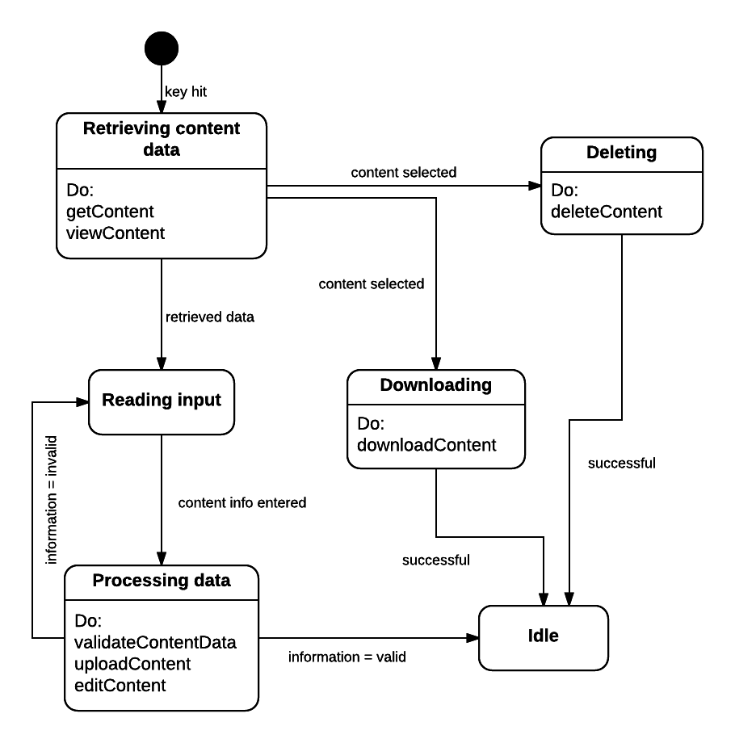
Behavioral Model
State diagram: Content

Slide 32
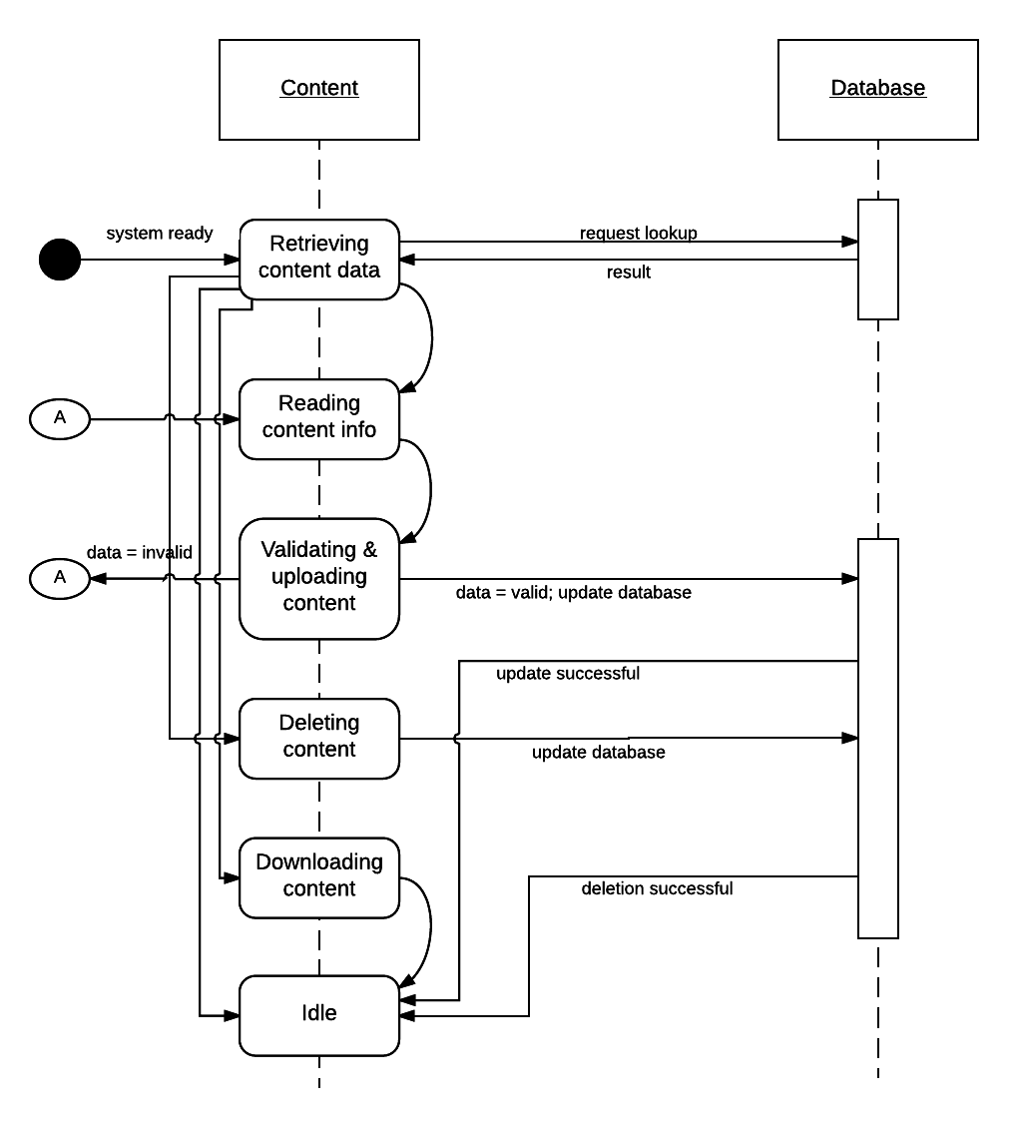
Behavioral Model
Sequence diagram: Content

Slide 33
References
Software Engineering – A Practitioner’s Approach, Roger S. Pressman
https://en.wikipedia.org/
http://stackoverflow.com/
https://www.lucidchart.com/

Slide 34

Q&A

Slide 35
Thank you

